Slide 1
Office excel
Part 1

Slide 2
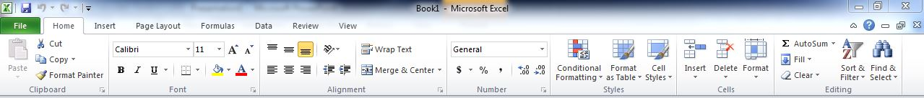
The ribbon
Home tab. It is the most used tab; it incorporated all text and cell formatting features such as font and paragraph changes. The home tab also includes basic spreadsheet formatting elements such as text wrap, merging cells and cell style.

Slide 3
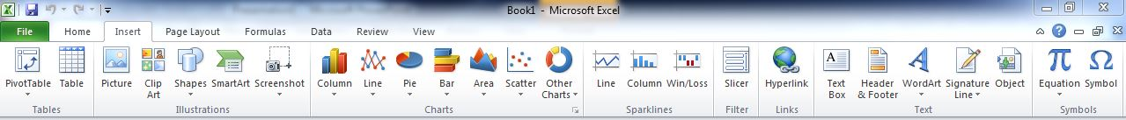
The ribbon
Insert tab. This tab allows you to insert a variety of items into a document from pictures, clip art, and headers & footers.

Slide 4
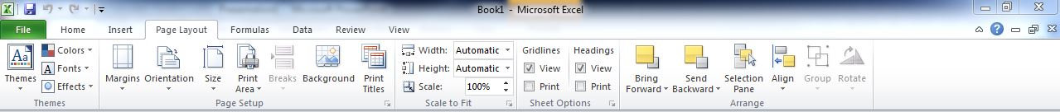
The ribbon
Page layout tab. This tab has commands to adjust page margins, orientation and themes.

Slide 5
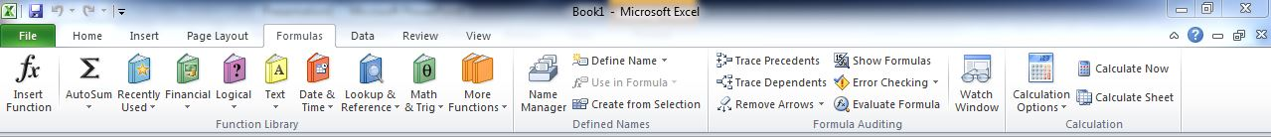
The ribbon
Formulas tab. This tab has commands to use when creating Formulas. This tab holds an immense function library which can assist when creating any formula or function in your spreadsheet.

Slide 6
The ribbon
Data tab. This tab allows you to modify worksheets with large amounts of data by sorting and filtering as well as analyzing and grouping data.

Slide 7
The ribbon
This tab allows you to correct spelling and grammar issues as well as set up security protections. It also provides the track changes and notes feature providing the ability to make notes and changes someone’s document.

Slide 8
The ribbon
This tab allows you to change the view of your document including freezing or splitting panes, viewing gridlines and hide cells.

Slide 9
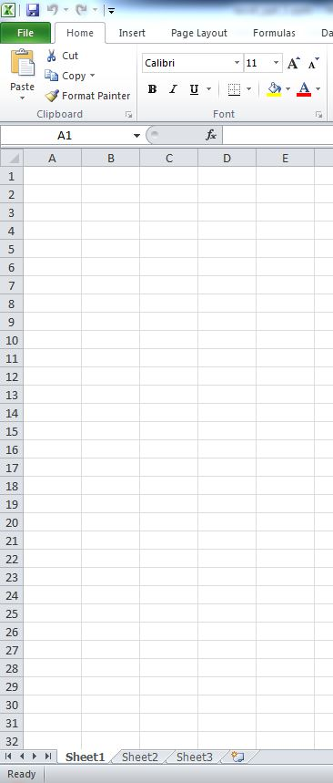
Create a new worksheet
When you open Excel, the default file is a workbook that consists of three spreadsheets. We will be working with only the first spreadsheet in the workbook. Double-click on the “Sheet 1” tab at the bottom of the worksheet and rename it GPA Calculator to make it easy to identify.

Slide 10
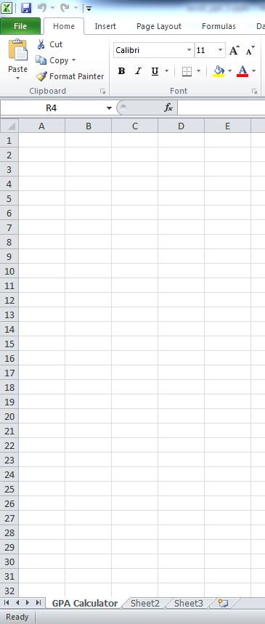
Create a new worksheet
Your new workbook should look like this. Next, save the file by clicking the ‘File’ tab at the top, click ‘save as’ and name it GPA Calculator.

Slide 11
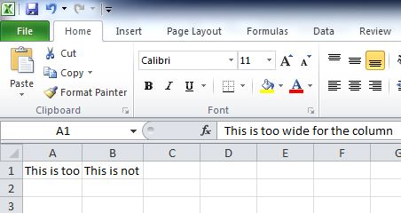
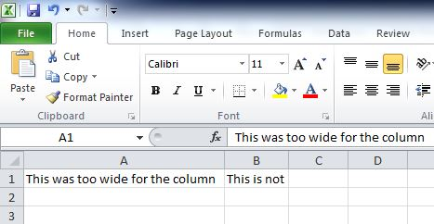
Create a new worksheet
As you type in data into the cells, you may notice the column width is narrower than the data you typed. If you would like to adjust the width of the columns, just place your cursor between the column letters until it turns into a cross hair and double-click to auto-adjust the width.

Slide 12
Create a new worksheet
Remember to…
SAVE YOUR WORK
FREQUENTLY!

Slide 13
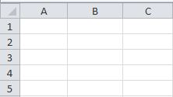
Entering Information into the Worksheet with Current Date & Time
Now you are ready to enter data. Remember that columns run from top to bottom vertically and are labeled using the alphabet. The rows or records run from left to right horizontally and are numbered. The GPA calculator will have a title, and include the date and time that it is completed. The date and time will be automatically generated from a formula when the worksheet is updated.

Slide 14

Entering Information into the Worksheet with Current Date & Time
To title the form, click on cell B1. Type “GPA Calculator”
To show when the file was updated, click on cell E1. Type ”Updated”
To show the current date, click on cell F1. Type ”=now() “ Remember to place the equal sign = in the formula.
Now press Enter.

Slide 15
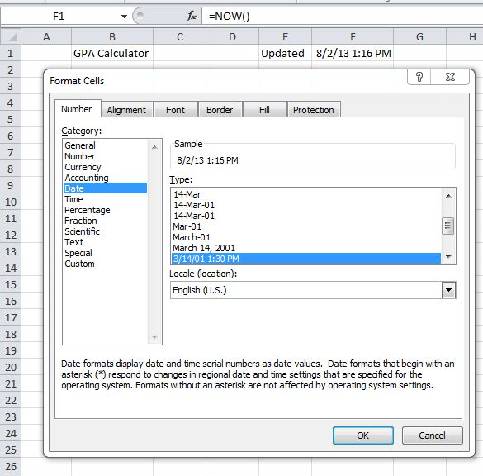
Entering Information into the Worksheet with Current Date & Time
To have the cell formatted for a date, right-click on cell F1. On the pop-up menu click on Format Cells > Number > Date.
Select a date format that shows both the date and time.

Slide 16
Entering Information into the Worksheet with Current Date & Time
Now we are ready to identify six column names for the GPA calculator:
Class (the course classification)
Course (the course number and name)
Credit (credit hours)
Grade (the grade the student made in the course)
Earned Credits (the credit hours earned)
Quality Points (the quality points earned)
Before you begin, make the columns wider so that you can see the data that you type into the cells.

Slide 17
Entering Information into the Worksheet with Current Date & Time
Click on cell A2. Type “Class”
Use the Tab key or point and click the mouse to move to cell B2. Type ”Course”
Repeat Step 2 to enter the remaining column headings: Credit; Grade; Earned Credits; Quality Points. Resize the columns so that you can view the column headings.
The next step is to enter all of the course information. Enter the Class, Course, and Credit data as shown on the next slide.

Slide 18
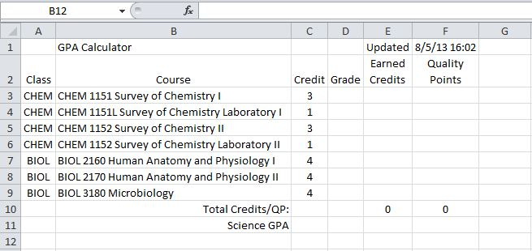
Entering Information into the Worksheet with Current Date & Time

Slide 19
Entering Information into the Worksheet with Current Date & Time
In cell B10, type Total Credits/QP. In cell B11, type Science GPA. Highlight cells B10 and B11, and then tap the Right Align icon in the menu bar. When you finish, resize the columns so that you can view all of the data.
You are ready to enter the formulas that calculate credit hours, quality points, and the GPA

Slide 20
Creating Calculated Fields
The grade point average is the sum of quality points divided by the number of earned credits. We need formulas to calculate the quality points and earned credits for each course listed on the GPA calculator. Afterwards, we will create a formula to sum the total earned credit hours and quality points. Finally, we will create a formula to calculate the GPA. To make things easier, we will create the formulas just once, then copy and paste them into the associated cells
The earned credits and quality points are calculated using the logical function IF, a very powerful formula. The IF formula is a conditional formula that returns one value if the condition you specify is TRUE, and another value if the condition is FALSE. You can include (nest) up to seven IF statements in a formula. If you make a mistake, don’t panic. Use the Undo Button, to restore the changes.

Slide 21
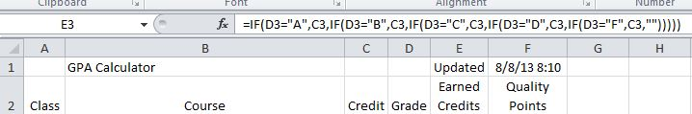
Step A: Formula for Earned Credit Hours
The formula in Column E for earned credits hours looks at the Grade and returns a numerical equivalent for the grade. In cell E3 type in the formula to determine the earned credit hours.
Type =IF(D3="A",C3,IF(D3="B",C3,IF(D3="C",C3,IF(D3="D",C3,IF(D3="F",C3,""))))) and tap the Enter key. Because there is no data in the Grade column, after you tap Enter nothing will show in that cell, but the formula will be visible in the formula bar.

Slide 22
Step A: Formula for Earned Credit Hours
What this somewhat intimidating formula means is this:
If the value in cell D3 is an “A” (the condition is TRUE), display the credit hours shown in C3.
If the value in D3 is a “B”, display the credit hours shown in C3.
If the D3 is a “C”, display the credit hours shown in C3 and so on.
The two double quotes at the end of the formula mean that if D3 is not equal to an “A”, “B”, “C”, “D”, or “F” (the condition is FALSE), leave E3 blank.

Slide 23
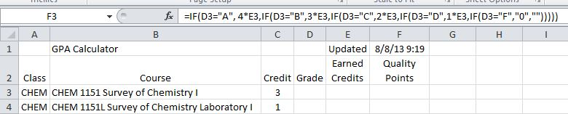
Step B: Formula to Calculate Quality Points
The next step is to type the formula to calculate the number of quality points. The Quality Points formula uses data for Grade and Earned Credits. The formula for Quality Points in Column F looks at the Grade in Column D and multiplies the associated Credit Hours in Column E times the equivalent Quality Points. In the example, we use the 4-point scale where an “A” is 4 points, a “B” is 3 points, a “C” is 2 points, a “D” is 1 point, and an “F” is 0 points.
Click in cell F3. Type =IF(D3="A",4*E3,IF(D3="B",3*E3,IF(D3="C",2*E3,IF(D3="D",1*E3,IF(D3="F","0",""))))) and tap the Enter key.

Slide 24
Step B: Formula to Calculate Quality Points
What the Quality Points formula in F3 means is this:
If D3 is an “A” (the condition is TRUE), then multiply the value in E3 (Earned Credits) times 4 (the quality points for an “A”).
If D3 is a “B”, then multiply the value in E3 (Earned Credits) times 3 (Quality Points for a “B”).
If D3 is a “C”, then multiply the value in E3 (Earned Credits) times 2 (Quality Points for a “C”) and so on.
If D3 is a “D”, then multiply the value in E3 (Earned Credits) times 1 (Quality Points for a “D”).
If D3 is an “F”, then the quality points for an “F” are 0.
If D3 is not equal to “A”, “B”, “C”, “D”, or “F” (the condition if FALSE), leave cell F3 blank.

Slide 25
Step B: Formula to Calculate Quality Points
Test the formulas to make sure that they work correctly. Type in the letter grade A in cell D3. You should see the number “3” in the E3 and the number “12” in F3. Test the formulas with the other letter grades, B, C, D and F. Type in something other than the letter grades and nothing should happen.
Now that we have created the formulas that calculate earned credit hours and quality points, we need to copy the formulas into cells for each of the courses.
Click on cell E3 and drag the mouse to F3 to highlight the cells.
Right-click the mouse and select Copy.
Highlight the cells E4 though F9. Right-click the mouse and select Paste.

Slide 26

Step C: Formulas to Sum Credit Hours and Quality Points
The next step is to create formulas to sum the credit hours and quality points. After we create the final two formulas, we will be ready to test the GPA calculator again.
Click on cell E10, and then click on the AutoSum icon in the menu bar.

Slide 27
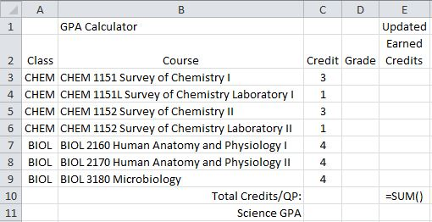
Step C: Formulas to Sum Credit Hours and Quality Points
Your screen should look like this:

Slide 28
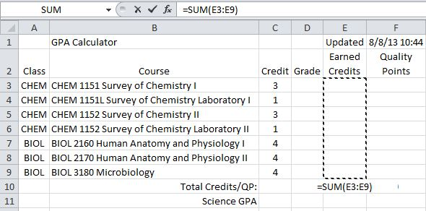
Step C: Formulas to Sum Credit Hours and Quality Points
Click in Cell E3 and drag the mouse to highlight Cells E3 through E9. The formula (=SUM(E3:E9) to sum their values is visible in the Formula Bar.

Slide 29
Step C: Formulas to Sum Credit Hours and Quality Points
Tap the Enter key to accept the formula.
Right-click on E10 and select Copy and then click on F10. Right-click and paste the formula into the cell.
Test the formulas once again using all of the grades. See the AutoSum Figure where showing testing with the letter grade “A.”
The next slide will show what your screen should look like after you type all “A’s” in the grade column.

Slide 30
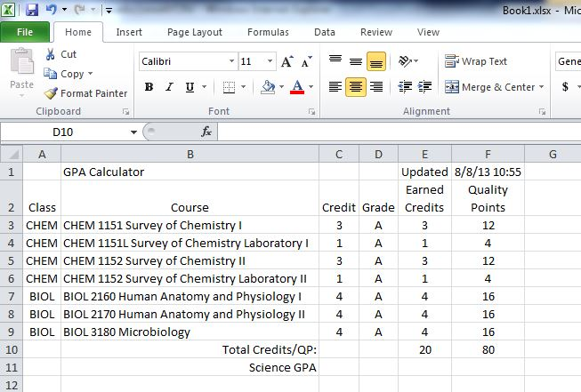
Step C: Formulas to Sum Credit Hours and Quality Points

Slide 31
Step D: Formula to Calculate the Science GPA
The last formula we create will be to calculate the Science GPA by dividing the sum of quality points in cell F10 by the sum of earned credits in cell E10. We’ll use another IF statement to prevent the error message “#DIV/0!” from showing up when the quality points in F10 is a “0” because no grades or the GPA is a 0 have been entered into the GPA calculator the GPA is a 0.
Click on cell F11. Type =IF(F10=0, "0", F10/E10)
Tap the enter key to accept the formula.
Test the GPA calculator by entering grades once again. Remember to save your file frequently!

Slide 32
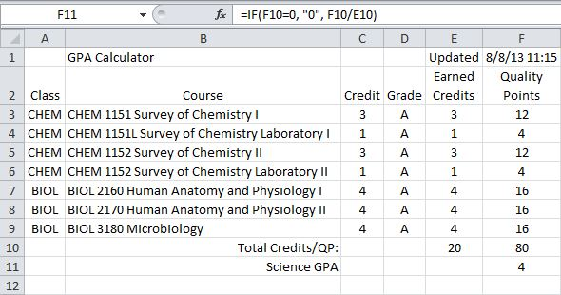
Step D: Formula to Calculate the Science GPA
Here is what your screen should look like now:

Slide 33
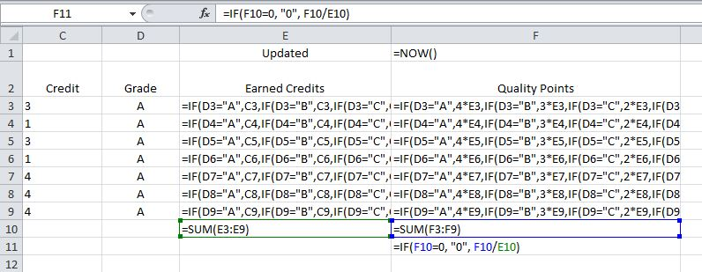
Conclusion
This figure shows all of the formulas in columns E and F used for the GPA calculator. To view the formulas in Excel, click the Control key and the tilde (~) key at the same time. Click them once again to return to the standard view.

Slide 34
Office excel
Part 2

Slide 35
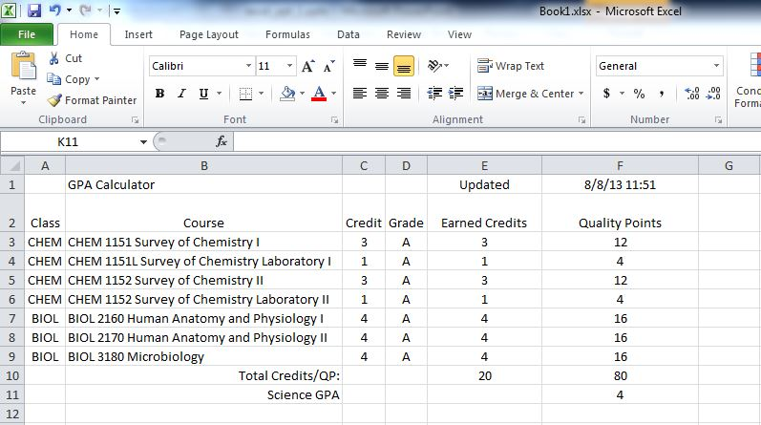
What we have so far
The figure below is where we should be at in Part 2 of Office Excel.

Slide 36
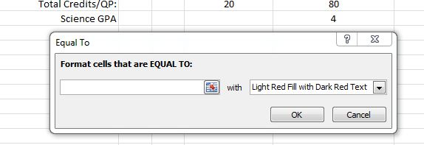
Using Conditional Formatting
If the student has made a D or F in a science course, the cell with the grade should be displayed in a orange or red color as a flag. The conditional formatting feature allows you to specify a cell shading or font color for a given condition. The condition is not case sensitive; you could type a “D” or “d” and the conditional formatting will still work.
Click on all of the cells from D3 through D9. Using the menu bar (ribbon) select Conditional Formatting -> Highlight Cells Rule -> Equal to… and your screen should look like this:

Slide 37
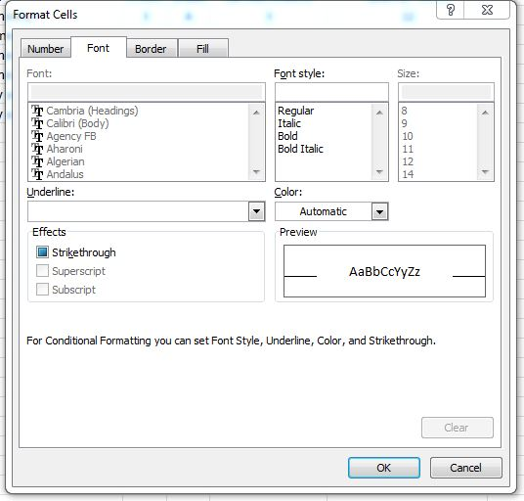
Using Conditional Formatting
Type (=“d”) in the text box. Click the dropdown box next to that and choose Custom Format… ,your screen will look like this:

Slide 38
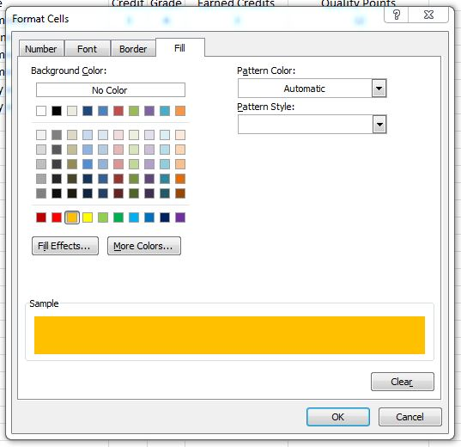
Using Conditional Formatting
Click the FILL tab, select the color orange and then click ok.

Slide 39
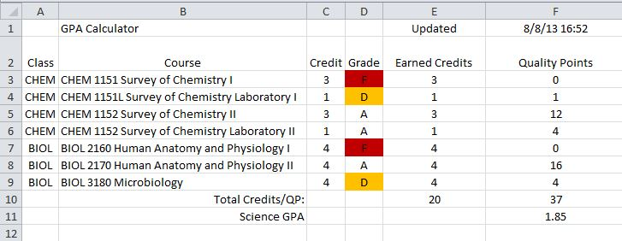
Using Conditional Formatting
Now that the letter grade of “D” is finished, you can try for the letter grade of “F” except we want the cell color to be red. Once you are finished, your screen should look like this:

Slide 40
Control and Protect Formulas
Finally, “protect” the formulas you created to prevent the user from accidentally corrupting them or deleting them. Excel offers the ability to protect part or all of a workbook, both with and without a password. IMPORTANT: All of the worksheet cells are “locked” by default, but only if the worksheet is protected. We need to specify the cells that we want the user to be able to modify, “unlock” those cells, and then protect the worksheet to prevent data entry in cells where there are formulas. We do not need to use a password to protect the data. Click in cell D3. Highlight D3 through D9.

Slide 41
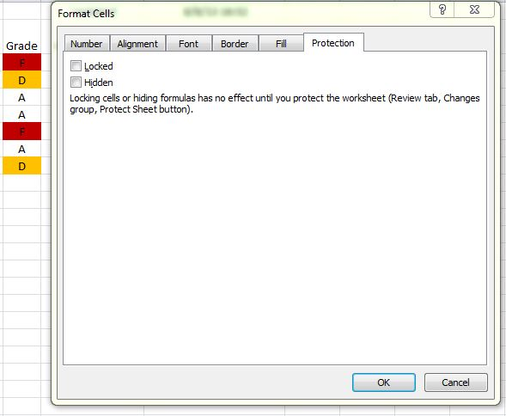
Control and Protect Formulas
Right-click > Format Cells > Protection > uncheck the Locked check box (remember that the cells are locked by default).

Slide 42
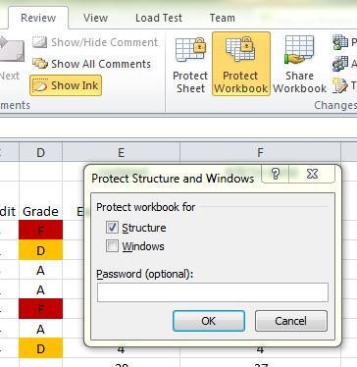
Control and Protect Formulas
Click anywhere on the spreadsheet to clear the selection, and then click the Review tab on the Ribbon, then click Protect Workbook. Leave the check mark in the box labeled Structure, then click OK.

Slide 43
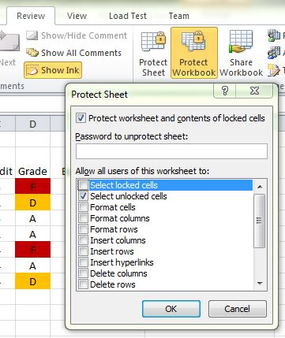
Control and Protect Formulas
Click anywhere on the spreadsheet to clear the selection, and then click the Review tab on the Ribbon, then click Protect Sheet. Uncheck the box labeled Select locked cells, then click OK.

Slide 44
Control and Protect Formulas
Once you have done that, the only cells that can be changed are D3 – D9, the grade cells. When we are finished with the presentation, You can unlock the workbook and sheet so you may modify the sheet anyway you choose.
Next you should test your GPA Calculator. Try other characters such as symbols, integers or capital letters. What happens when you enter any of these?

Slide 45
Save the Worksheet as a Template File
DO NOT DO THIS SECTION UNLESS YOU ARE USING YOUR OWN COMPUTER!
The GPA calculator is now functional. Go ahead and save the file as a template file. The template file is a master file that is stored with all of the other MS Office templates. This template can be accessed time and again and provide you a fresh start to a new grade calculator sheet. It can also refresh your memory for the formulas you’ll need.
Click on File tab -> Save As
Name the file GPA Calculator and then click the down arrow by the Save as type drop-down menu. Select Excel Template.
WARNING! DO NOT CHANGE WHERE THE FILE IS SAVED!

Slide 46
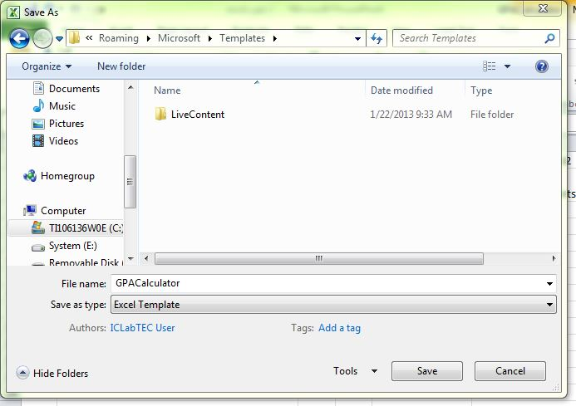
Save the Worksheet as a Template File
MS Office will automatically default to saving the file in the Templates folder (See below). Click the “OK” button.

Slide 47
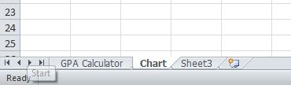
Creating a Bar Chart
In this part of the presentation we will create a simple bar chart. First we need a blank sheet. In order to do this we need to remove the protection we placed earlier.
Click the Review tab then click Protect Workbook, then click Protect sheet. Now we can edit the workbook.
Click the Sheet2 tab at the bottom of the workbook. Rename it Chart like you did before. After you are finished, your page should look like this:

Slide 48
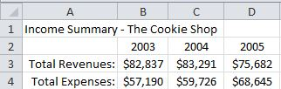
Creating a Bar Chart
Enter the data as you see here. Try to align and center the information yourself.

Slide 49
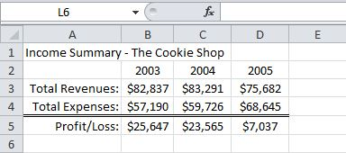
Creating a Bar Chart
Now, try to make your chart information exactly like you see. Please do not type in the profit/loss values. Use a formula. It is important that there are no blank cells.

Slide 50
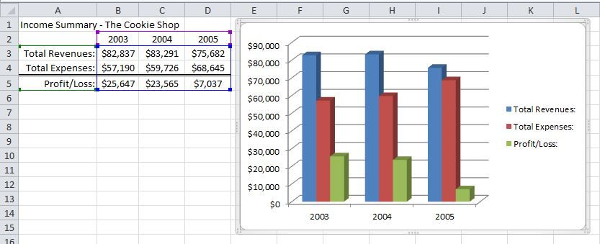
Creating a Bar Chart
Highlight the range of cells from A2 to D5, which includes the column titles and the row headings.
Click on the Insert tab on the ribbon.
In the chart category, click Column -> 3-D Column -> 3D-Clustered Column. If everything is correct, your screen should look like this.

Slide 51
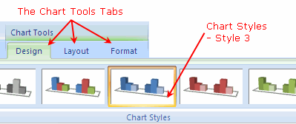
formatting a Bar Chart
When you click on a chart, three tabs - the Design, Layout, and Format tabs are added to the ribbon under the title of Chart Tools.
Click on Chart Styles – Style 3 as seen in the above image.
Click on the Layout tab, then click on Chart Title -> Above Chart.
Type in the title 2003 - 05 Income Summary.

Slide 52
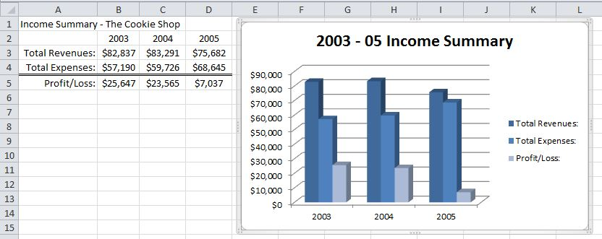
formatting a Bar Chart
And this is what you should see:

Slide 53
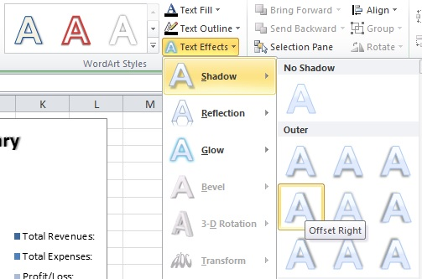
formatting a Bar Chart
Click on the chart title then highlight the text.
Click on the Format ribbon tab.
Choose Text Effects -> Shadow -> Outer -> Offset Right.

Slide 54
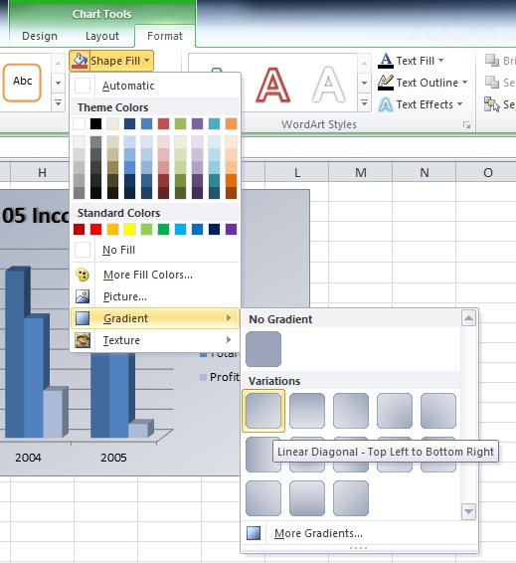
formatting a Bar Chart
Click the Format tab under Chart Tools.
Next click Shape Fill -> Gradient -> Variations -> Linear Diagonal – Top Left to Bottom Right.

Slide 55
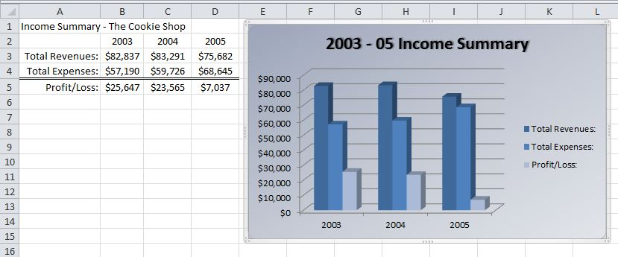
formatting a Bar Chart
This is what your chart should look like now:

Slide 56
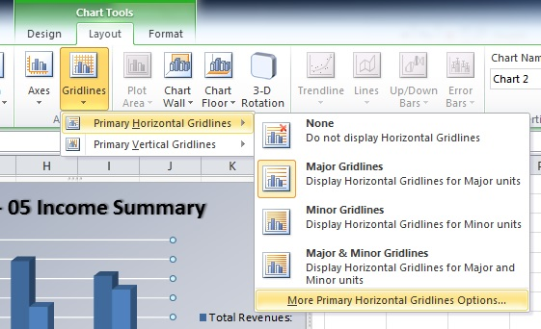
formatting a Bar Chart
To change the color of the gridlines, click the Layout Tab under Chart Tools on the ribbon.
Click Gridlines -> Primary Horizontal Gridlines -> More Primary Gridline Options…

Slide 57
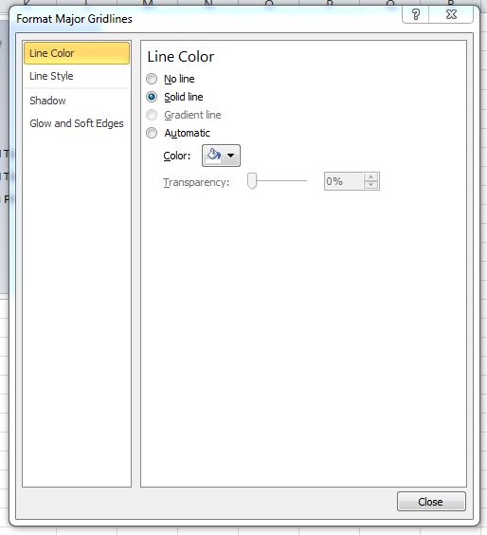
formatting a Bar Chart
Choose Line Color > Solid Line and set the line color to white from the dropdown box. Then click close.

Slide 58
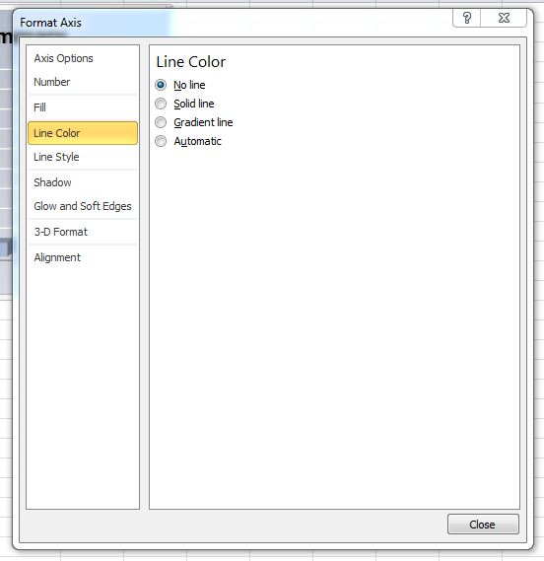
formatting a Bar Chart
Click Axes -> Primary Vertical Axis -> More Primary Vertical Axis Options…
After the Format Axis menu pops up, click Line Color -> No Line.

Slide 59
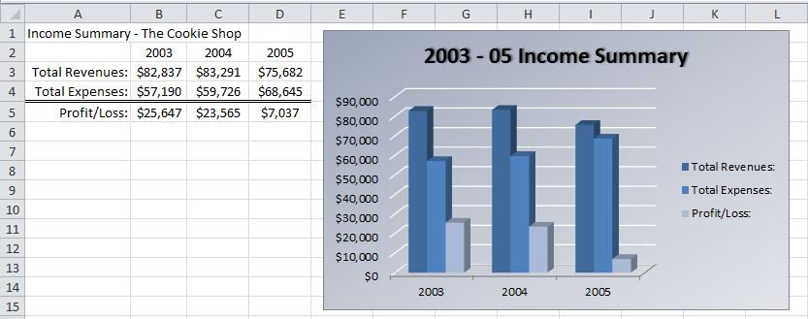
formatting a Bar Chart
We are almost finished! The chart should look like the one below:

Slide 60
formatting a Bar Chart
The chart floor needs to be colored so click Layout tab under Chart Tools on the Ribbon.
Click Chart Floor -> More Floor Options -> Fill -> Solid Fill -> Close. Now your chart should look like…

Slide 61
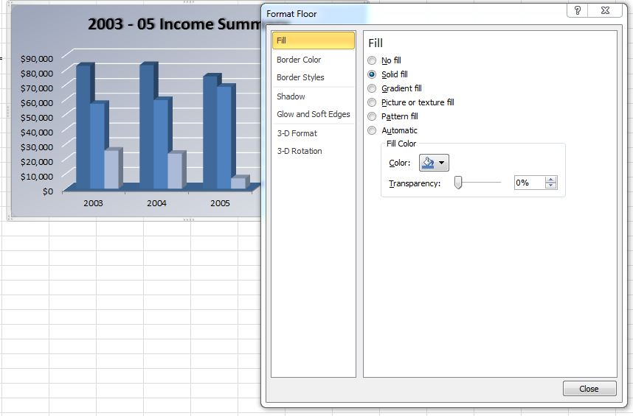
formatting a Bar Chart

Slide 62
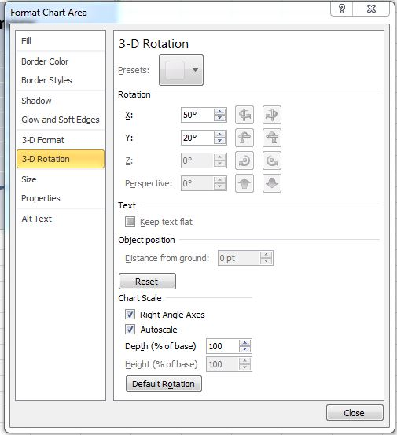
formatting a Bar Chart
The last thing that needs to be done is applying a 3-d rotation to the chart .
Click Layout tab under Chart Tools on the Ribbon.
Click 3-D Rotation then change the values in X: & Y: to 50° and 20° respectively:

Slide 63
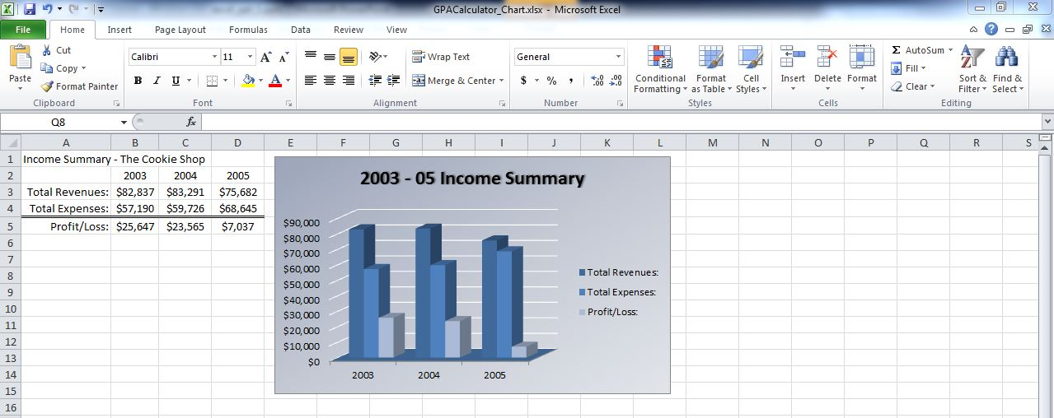
conclusion
There we have it! The chart is complete and it finally should look like:

Slide 64
conclusion
REMEMBER!
ALWAYS SAVE YOUR WORK OFTEN.

